Slide 1
MTA Subway Terminal On-Time Performance ANALYSIS
BIA 610 : Applied Analytics Final Project by:
Sai Sruthi Chalasani
Sahithi Setty
Venkata Sandilya Bagavathula

Slide 2
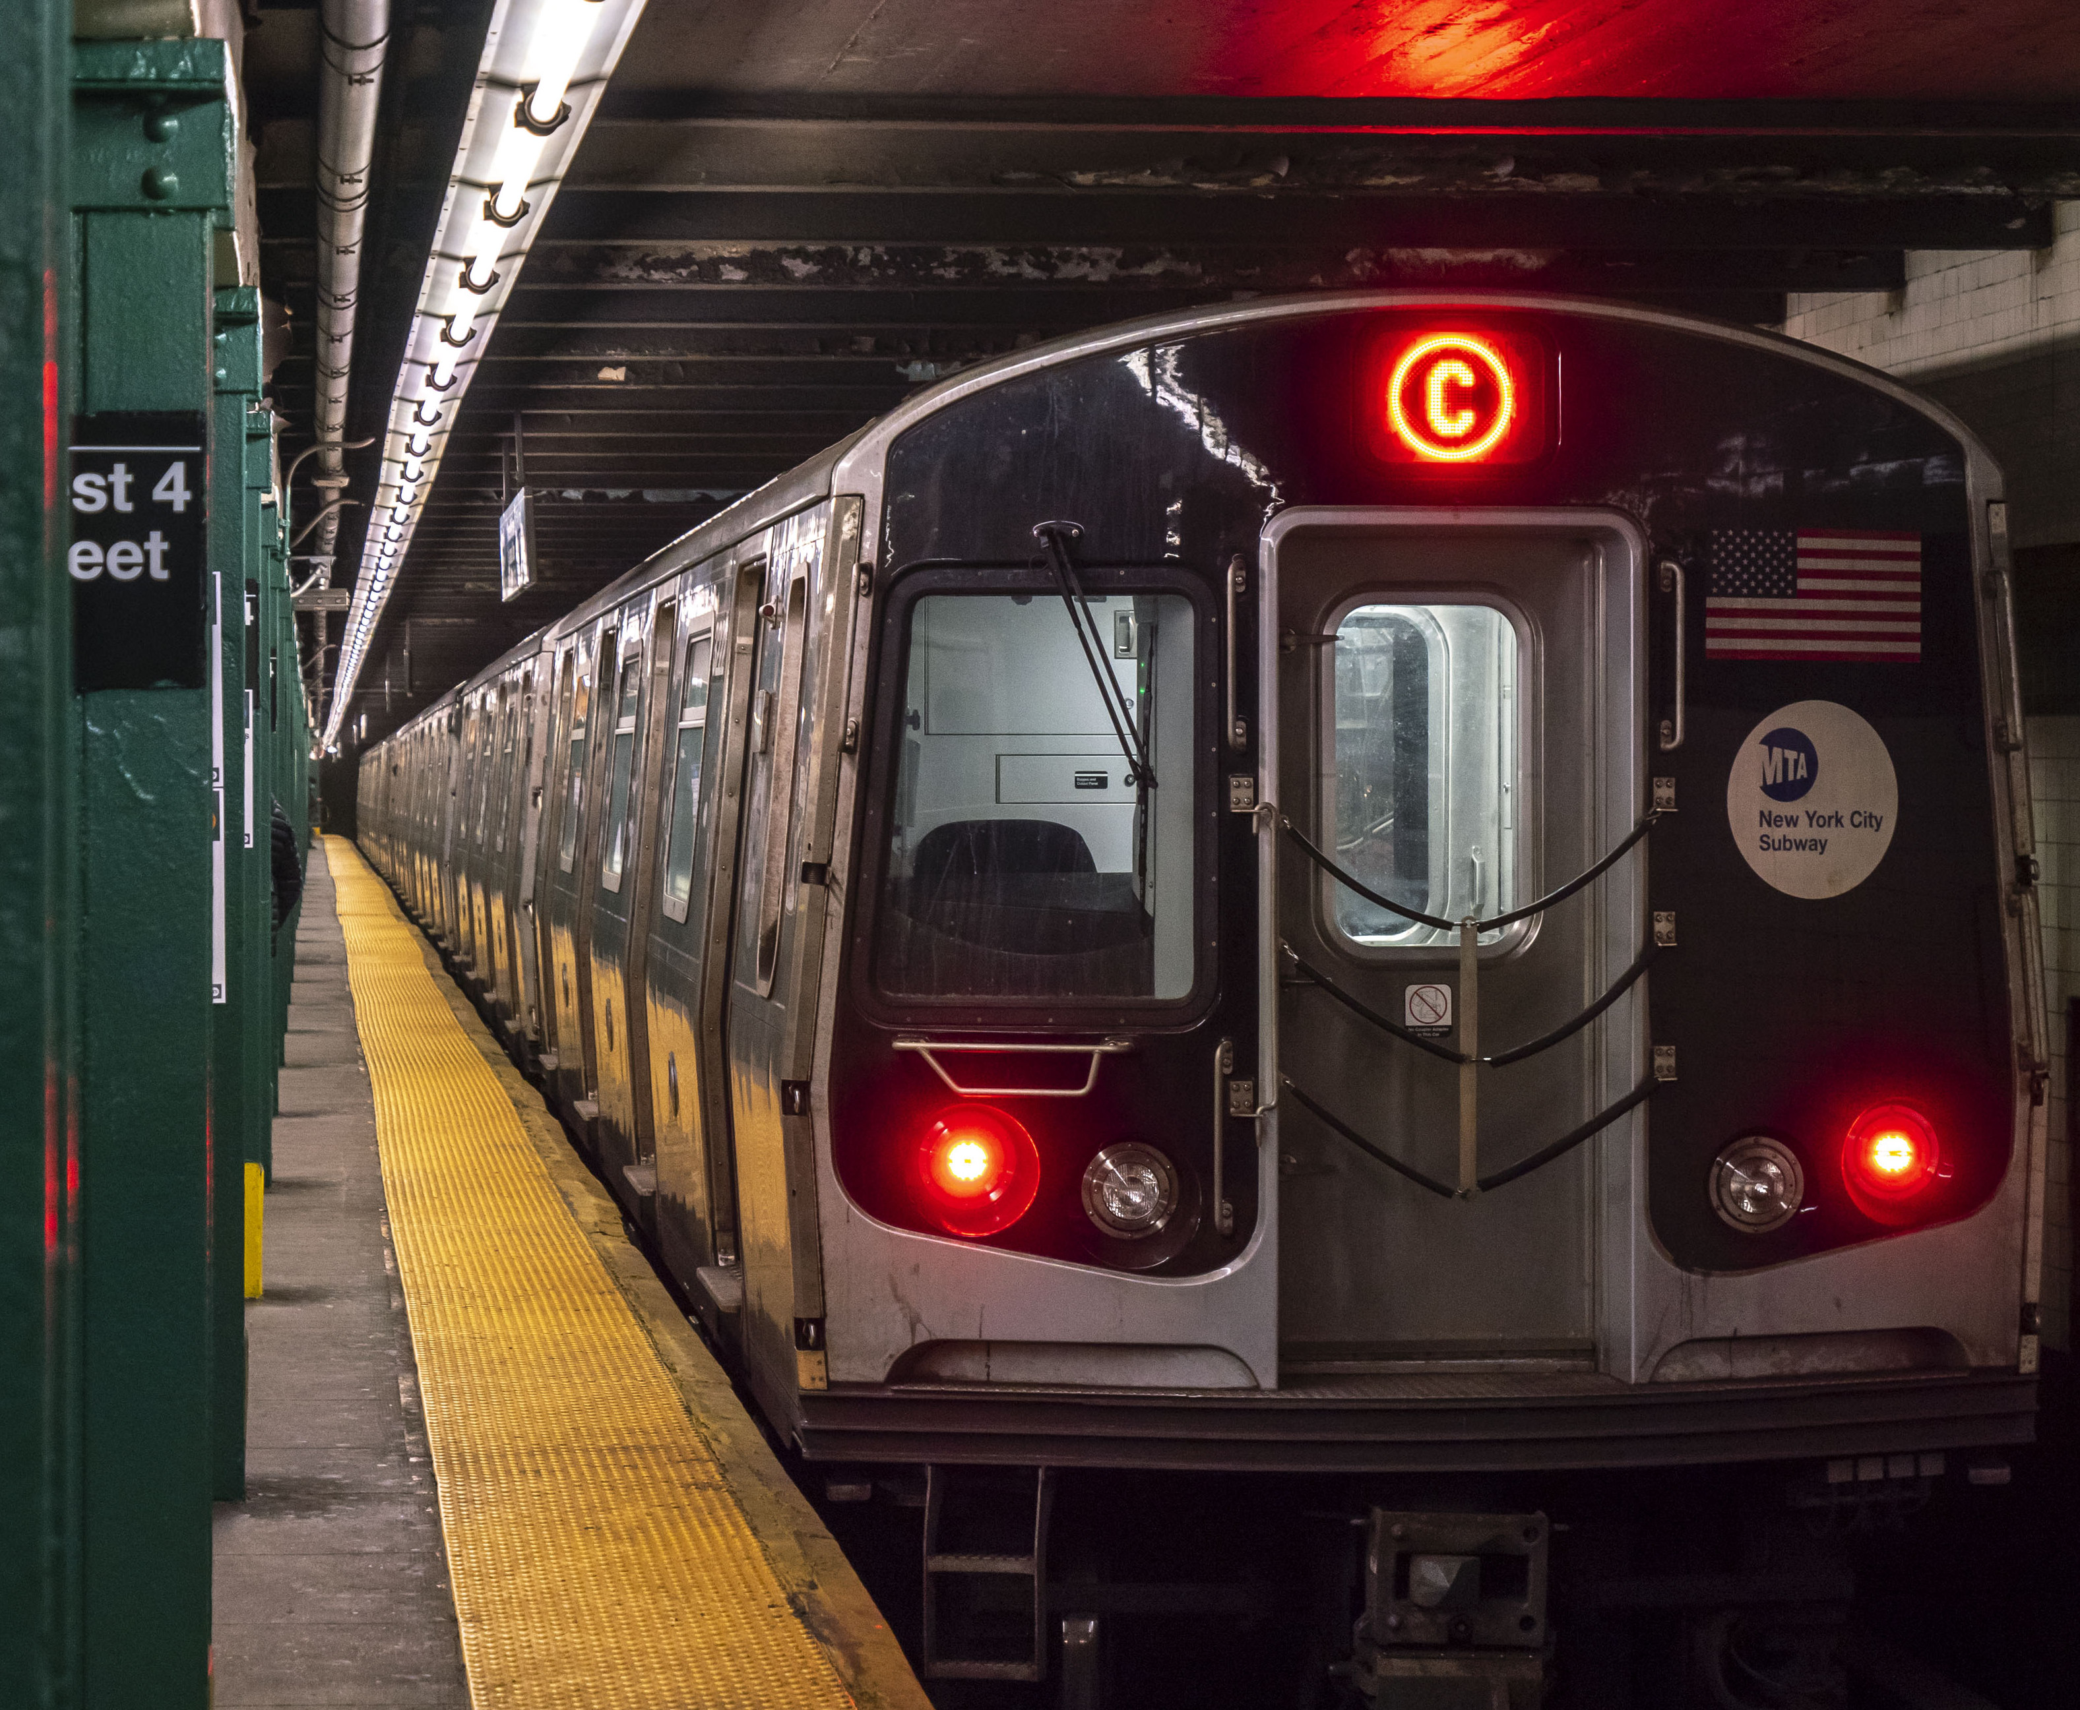
INTRODUCTION
MTA: New York City Subway Transit
The MTA subway is a crucial transportation system for the people of New York City, providing reliable and affordable access to work, education, and leisure activities. It is a vital component of the city's infrastructure and economy.
With millions of people depending on it every day, it's crucial that the subway runs smoothly and efficiently. In order to ensure that trains arrive on time and that the system is operating at peak performance, it's essential to understand how the system is performing.

Slide 3
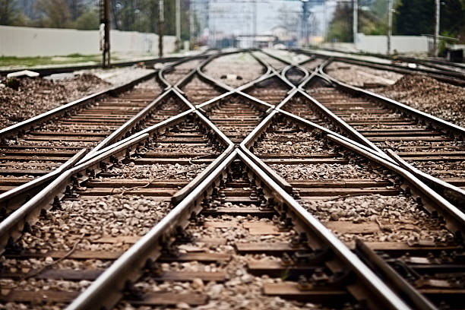
INTRODUCTION
Analyzing New York City's Subway System Performance
In this analysis, we explore the on-time performance of the MTA subway system from 2015 to 2019. We aim to answer several business questions such as identifying the best and worst on-time terminal performances by year and line, understanding how terminal on-time performance varies by month and line, and identifying the top 7 lines with the best on-time performance. Analysis of Subway Lines based on Track Counts was also done.

Slide 4

INTRODUCTION
Benefits to the users
The analysis will provide insights to the users into the reliability and efficiency of the subway system. Understanding which lines and terminals have the best on-time performance can help commuters plan their routes and schedules more effectively. Additionally, identifying the busiest stations can help commuters avoid potential crowds and delays. Overall, by analyzing the subway system's on-time performance, we can gain a better understanding of its strengths and weaknesses and make more informed decisions as subway users.

Slide 5
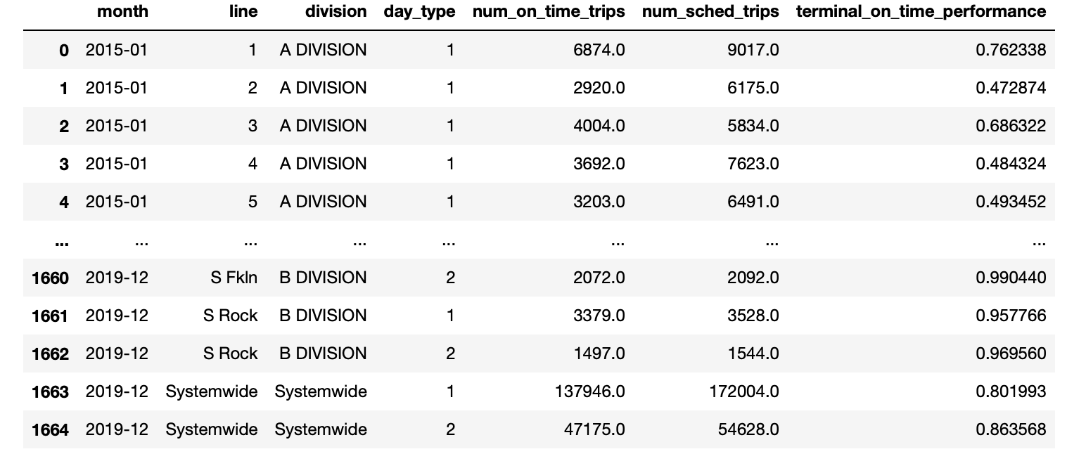
DATA PREPARATION
The dataset
The dataset was sourced from data.gov. It includes the information on the on-time performance of subway terminals inNew York City between 2015-2019.
The dataset has 7 columns: month, line, division, day_type, num_on_time_trips, num_sched_trips, and terminal_on_time_performance. [1665 rows × 7 columns]
The month column indicates the month and year and the "line" column indicates the subway line (e.g., 1, 2, 3, A, B, C, S 42nd, S Fkln, S Rock).
The "division" column indicates the subway division (A or B Division) while the day_type column indicates whether the data was collected on a weekday (1) or a weekend (2).
The "num_on_time_trips" column indicates the number of on-time trips recorded for the given terminal, line, division, and day type.
The "num_sched_trips" column indicates the number of scheduled trips recorded for the given terminal, line, division, and day type.
The "terminal_on_time_performance" column indicates the percentage of on-time trips for the given terminal, line, division, and day type.

Slide 6
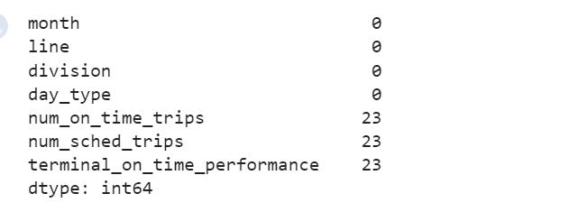
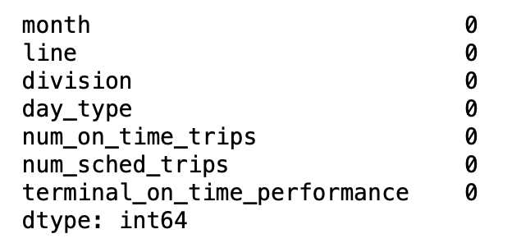
DATA PREPARATION
There were 23 null values in the columns 'num_on_time_trips', 'num_sched_trips', and 'terminal_on_time_performance’.
The mean of the three columns was calculated, then it was used to fill the missing values.
This is done using the "fillna" method of the pandas DataFrame, which replaces any missing values in a specified column with the provided value

Slide 7
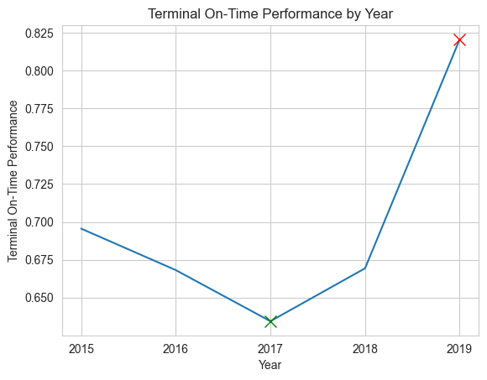
EXPLORATORY DATA ANALYSIS
1. The best and worst "on-time terminal performance" by year
Best on-time terminal performance was in 2019 and worst was in 2017

Slide 8
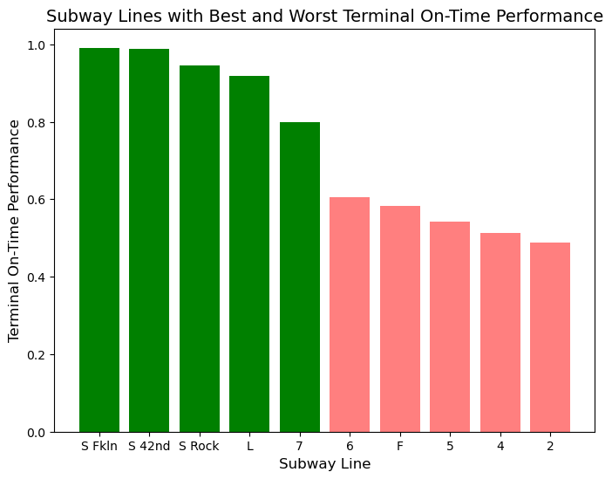
EXPLORATORY DATA ANALYSIS
2. Best and worst terminal on-time performance by line
The line S Fkln had the best on time performance while line 2 had the worst

Slide 9
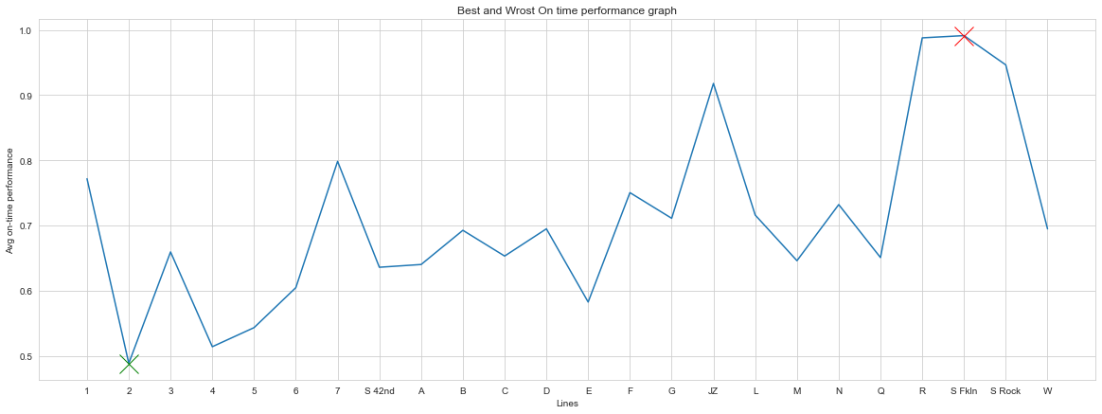
EXPLORATORY DATA ANALYSIS
2. Best and worst terminal on-time performance by line

Slide 10
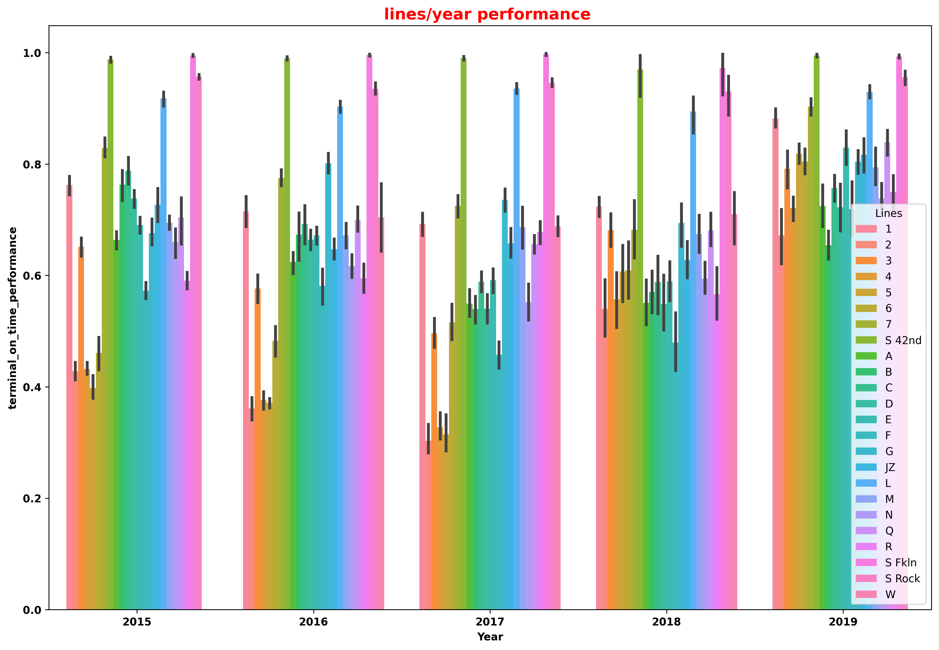
Bar plot for lines/year performance
This graph bar plot shows the performance of different subway lines based on the terminal on-time performance over the years.
Each line is represented by a different color.
This graph helps us to analyze the performance of different lines over the years.

Slide 11
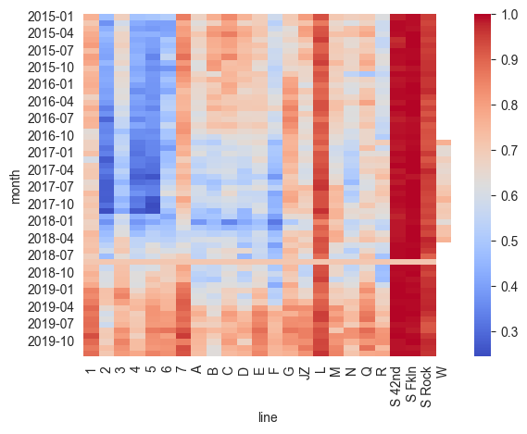
EXPLORATORY DATA ANALYSIS
3. How does terminal on-time performance vary by month and line?
The heatmap visualizes the mean terminal on-time performance for each month and subway line. The color to represents the performance value for each cell.

Slide 12
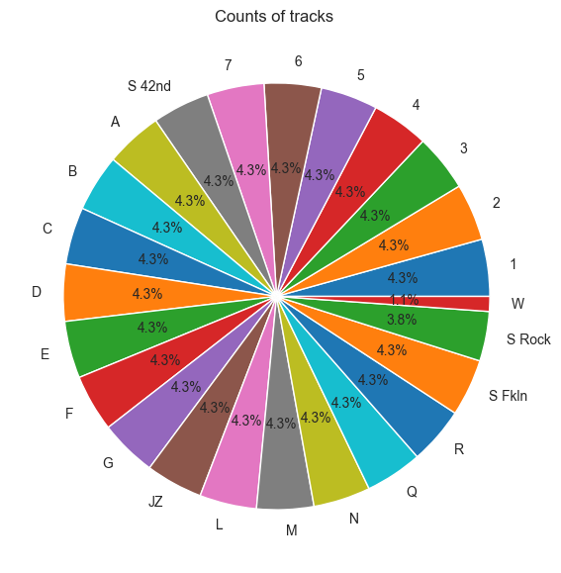
4. Analysis of Subway Lines based on Track Counts
EXPLORATORY DATA ANALYSIS
The pie chart shows the percentage of the trains scheduled for each line over the year 2015-2019

Slide 13
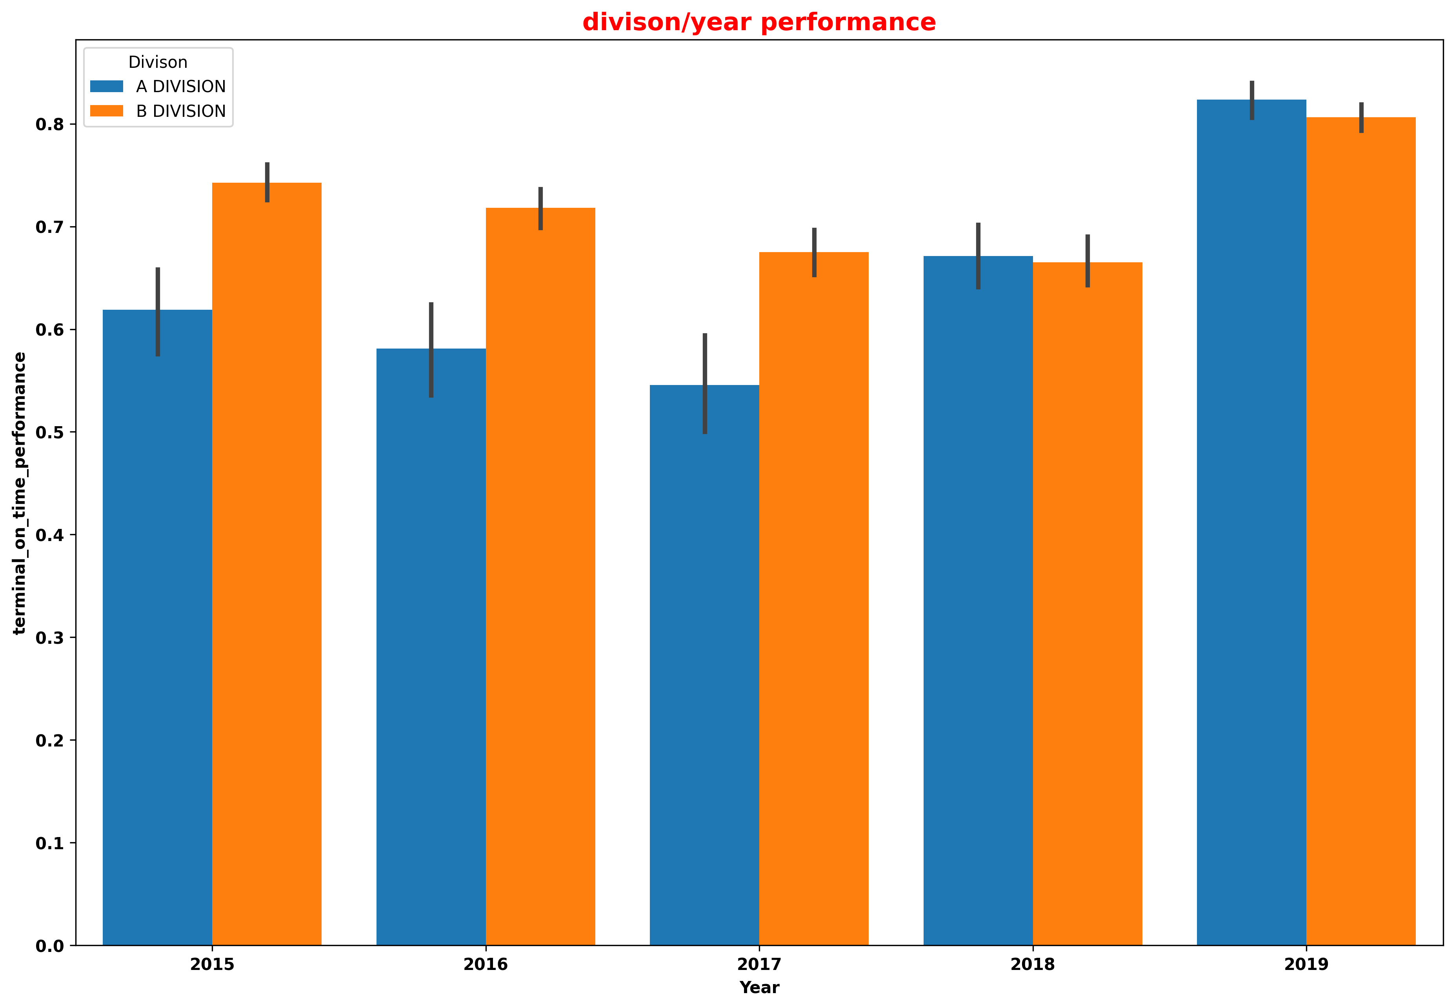
5. Performance Based on Division/Year
EXPLORATORY DATA ANALYSIS
This bar plot displays the performance based on division. Each bar represents a year and is colored by division.
The height of each bar corresponds to the average terminal on-time performance for that year.
The plot allows us to compare the performance of different divisions over time.

Slide 14
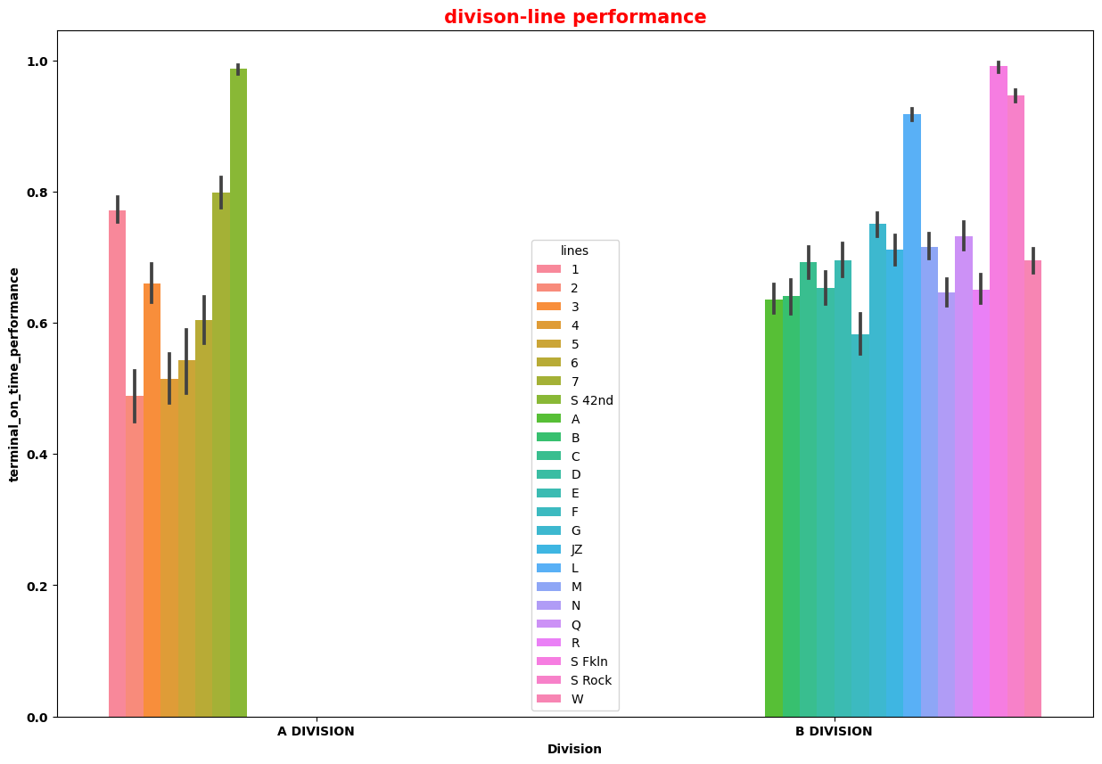
5. Bar plot Based ON Division-Line Performance
This plot shows the on-time performance of the different lines across the 2 divisions separately.

Slide 15
PREDICTIVE ANALYSIS
The term predictive analytics refers to the use of statistics and modeling techniques to make predictions about future outcomes and performance. Predictive analytics looks at current and historical data patterns to determine if those patterns are likely to emerge again.
Analyze what are input and Output features
Transform and arrange the data set accordingly
Perform Data cleaning, feature scaling and normalization
Split the data into test and train
Apply the ML model of your choice to train it
Predict the output target values
Use metrics like Accuracy, MSE, RMSE etc. for validation/ Evaluation purposes
8. Observe the predictions and do improvements

Slide 16
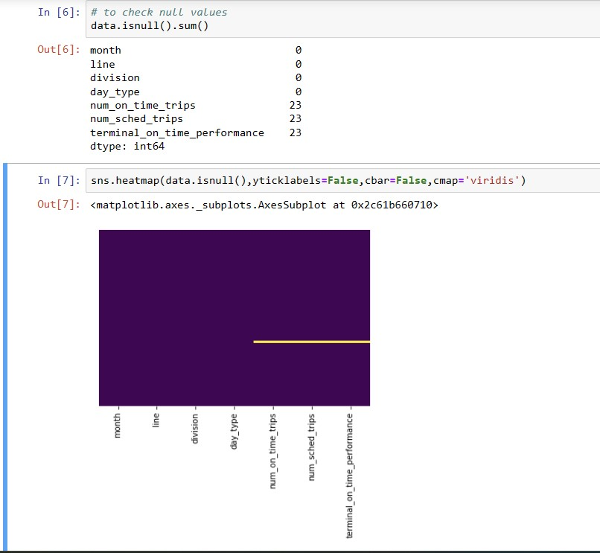
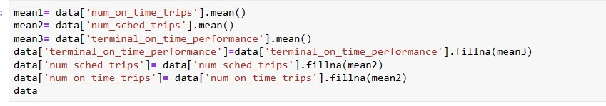
Step 1: Data Cleaning and Preprocessing
Clean and preprocess the data to remove any errors, inconsistencies, or missing values. Data preprocessing includes tasks such as data normalization, feature scaling, and data transformation.
Dealing with missing data
1 .Here in the data set, there are 23 missing values.
2. The visualization of these missing values can be done using Heat map plot.
3. To deal with missing data, here I used mean imputation
shown below:
4. The above code replaces all null values in the data with mean value
5. Removed Sytsem_wide rows, which is not needed

Slide 17
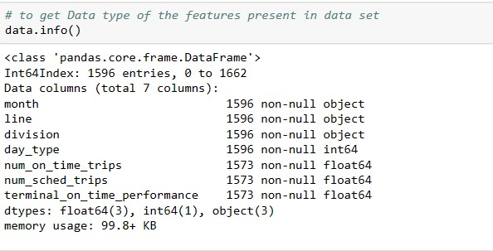
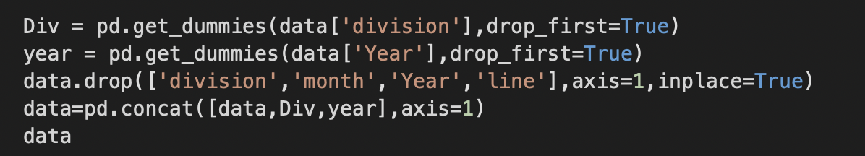
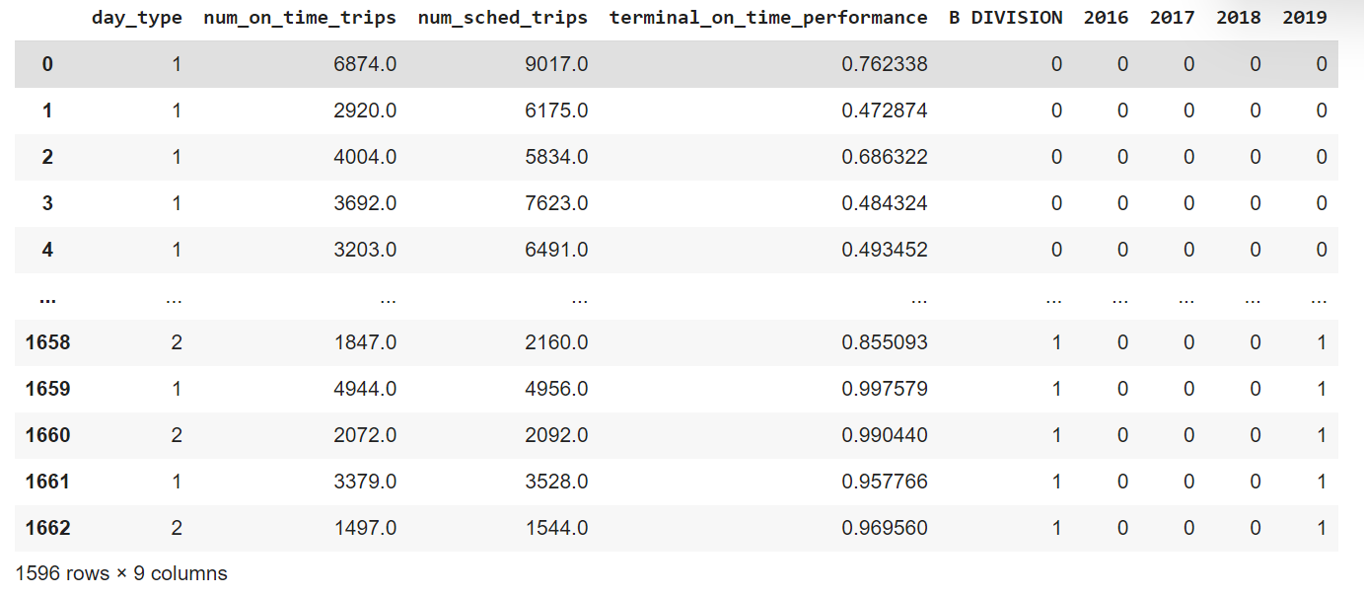
2. Data Transformation / Feature Scaling
Using data.info() we can find the data-type of all the features present in the data set.
As seen from the pic, we have 3 categorical features and 4 numerical features. Therefore, to proceed further we need to convert these categorical values to numerical values, so that it can be used as ML model input feature
The pd.get_dummies() function takes a categorical variable and converts it into a set of binary variables, where each variable represents a unique category in the original variable. Each observation in the original variable is replaced by a set of binary variables, where the value of each binary variable indicates whether or not the observation belongs to that category.

Slide 18
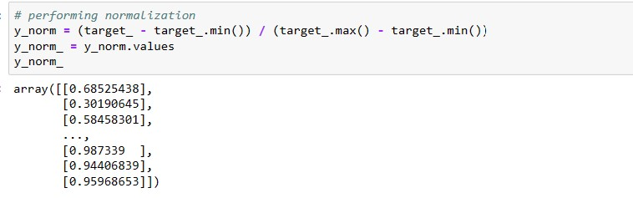
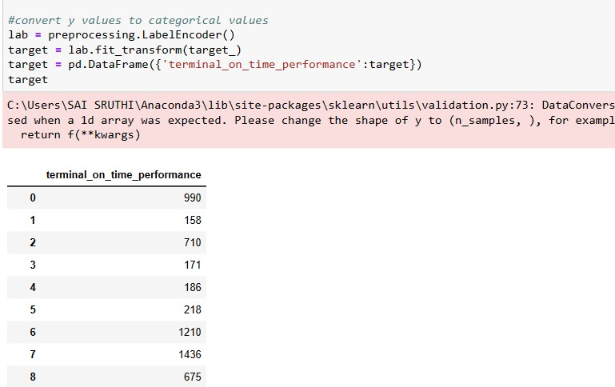
3. Normalization
Normalization is a common preprocessing technique used to transform continuous variables so that they have a specific scale or distribution. The goal of normalization is to make the variables more comparable and to improve the performance of machine learning models that use these variables as input.
Some machine learning algorithms, such as k-nearest neighbors, support vector machines, and gradient descent algorithms, are sensitive to the scale of the input variables. If the input variables are on different scales, the algorithm may give too much importance to some variables and too little importance to others, leading to poor performance. Ex; Z-score normalization and Min-Max scaling

Slide 19
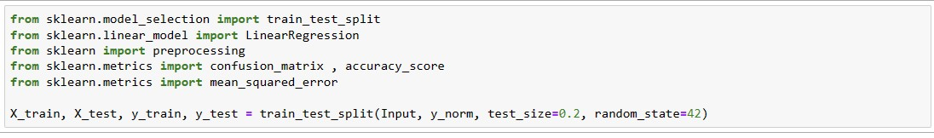
3. Split the data set to train and test
we divide the data into two sets: a training set and a test set. The training set is used to train the machine learning model, while the test set is used to evaluate the performance of the model
Import the necessary libraries. Some of the common libraries used in data science are NumPy, Pandas, and Scikit-learn.
Separate the target variable from the features. The target variable is the variable you want to predict, while the features are the input variables.
Split the data into training and testing sets using Scikit-learn's train_test_split function. This function randomly splits the data into two sets based on a specified test size or train size. The typical split ratio is 80% for training data and 20% for testing data.

Slide 20
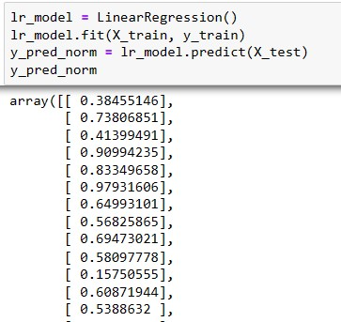
3. Model Prediction
We used two machine learning models to predict the on-time performance:
Linear Regression
2. Random Forest
Create an instance of the Linear Regression model using Scikit-learn's LinearRegression function.
Train the model using the training data. This is typically done by calling the fit method on the Linear Regression model.
Use the trained model to make a prediction on new data. This is typically done by calling the predict method on the Linear Regression model and passing in the new data, which is y_pred_norm.
Evaluate the performance of the model. This is typically done by calculating metrics such as mean squared error, R-squared, or mean absolute error.

Slide 21
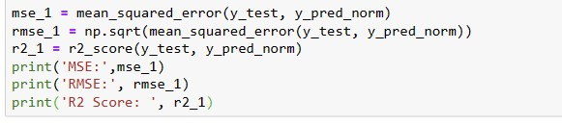
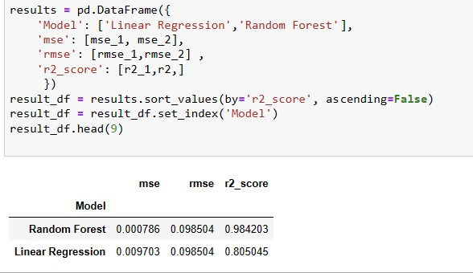
3. Model Evaluation and Results
We used the following measurement techniques to evaluate performance:
Mean Absolute Error (MAE) — the mean of the absolute value of the errors
Root Mean Squared Error (RMSE) — the square root of the mean of the squared errors
If we have two arrays of continuous values, we can calculate the MSE as the average absolute difference between the predicted and actual values.
Results of two models is printed and It is observed that random forest performance is better when compared to Linear Regression

Slide 22
SUMMARY
Based on the EDA analysis conducted, the following observations were made:
The year 2019 showed the best on-time terminal performance, while 2017 showed the worst.
Day_type 2, which represents evening schedules, was introduced in April 2019.
The S FKln subway line had the best on-time performance across all five years, while the '2' subway line had the worst performance.
Most of the subway lines are under division B.
Subway tracks "W" and "S-Rock" had the least train schedules compared to other lines, which had an equal number of scheduled trains.
Subway tracks "W" and "B" did not have any Day_type 2 schedules, in all the years.
The first eight tracks are under A-division, and the rest are under B-division.
Overall, these observations provide insights into the on-time performance of different subway lines, schedules, and divisions over a period of five years.

Slide 23
Limitations
The following steps could be taken to improve this work:
Use more advanced machine learning models with richer features, for example, we may include month information as part of the features to get better prediction results, by using date time conversion formatting
More real data can be collected with more features to make the analysis better
Use data from multiple years to capture year-to-year trends

Slide 24
ANY QUESTIONS?
MTA Subway Terminal On-Time Performance ANALYSIS

Slide 25
Thank you!

